Slide 1
INFORMATION SYSTEMS, ORGANIZATIONS, AND STRATEGY

Slide 2
CHAPTER 3: INFORMATION SYSTEMS, ORGANIZATIONS,
AND STRATEGY
Organizations and Information Systems
Information technology and organizations influence one another
  Complex relationship influenced by organization’s
    Structure
    Business processes
    Politics
    Culture
    Environment, and
    Management decisions
© Pearson Education 2012
Notes:
This concept was briefly discussed in Chapter 1. Figure 1-2 and 1-3 as well as the figure on the next slide, 3-1, display this interdependent relationship graphically.

Slide 3
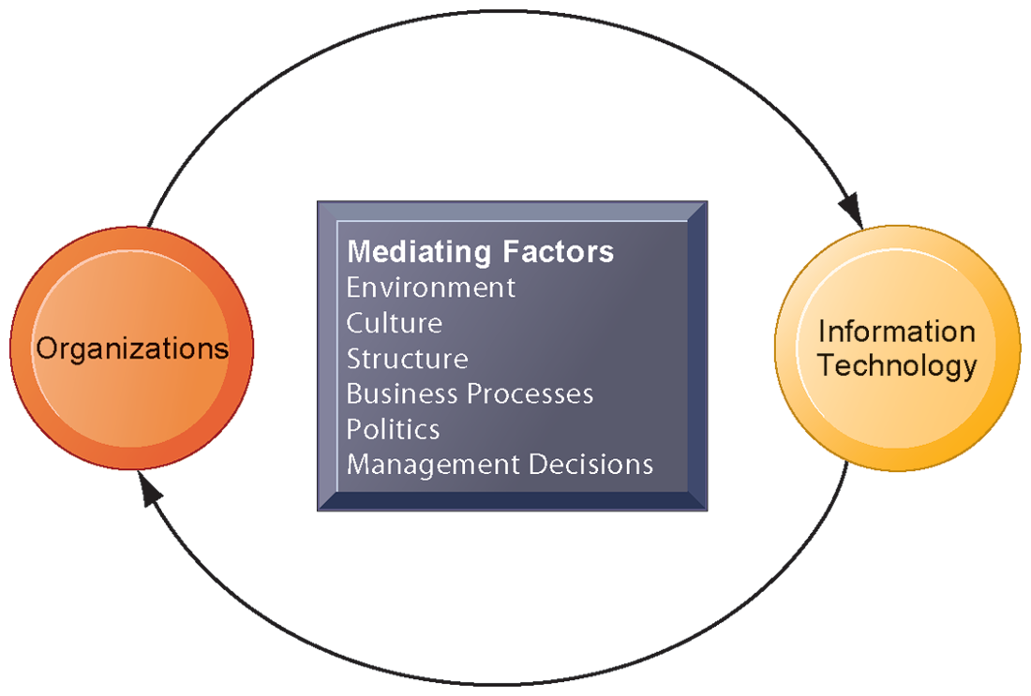
CHAPTER 3: INFORMATION SYSTEMS, ORGANIZATIONS,
AND STRATEGY
Organizations and Information Systems
THE TWO-WAY RELATIONSHIP BETWEEN ORGANIZATIONS AND INFORMATION TECHNOLOGY
This complex two-way relationship is mediated by many factors, not the least of which are the decisions made—or not made—by managers. Other factors mediating the relationship include the organizational culture, structure, politics, business processes, and environment.
FIGURE 3-1
© Pearson Education 2012
Notes:
Ask students to explain how each factor might affect the relationship between organizations and information technology. Emphasize to students that the relationship between these two and its effects on the future of a business are difficult to predict. For example, very few people could have predicted the prominence of e-mail and instant messaging in business communication 15 years ago.

Slide 4
CHAPTER 3: INFORMATION SYSTEMS, ORGANIZATIONS,
AND STRATEGY
Organizations and Information Systems
What is an organization?
  Technical definition:
    Stable, formal social structure that takes resources from environment and processes them to produce outputs
    A formal legal entity with internal rules and procedures, as well as a social structure
  Behavioral definition:
    A collection of rights, privileges, obligations, and responsibilities that is delicately balanced over a period of time through conflict and conflict resolution
© Pearson Education 2012
Notes:
Which of the two definitions do students find more accurate and why? It is important to consider both definitions rather than exclusively use one at the expense of the other. The two definitions are complementary.

Slide 5
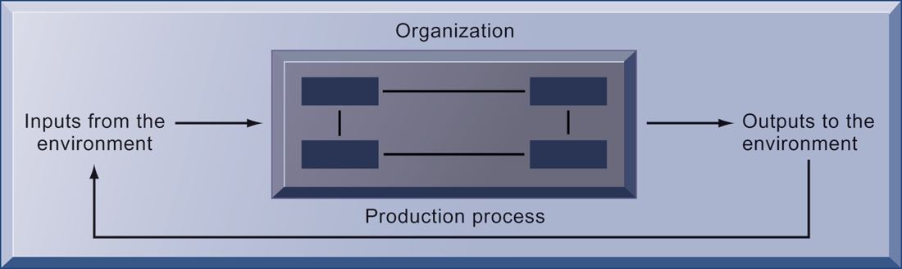
CHAPTER 3: INFORMATION SYSTEMS, ORGANIZATIONS,
AND STRATEGY
Organizations and Information Systems
THE TECHNICAL MICROECONOMIC DEFINITION OF THE ORGANIZATION
FIGURE 3-2
In the microeconomic definition of organizations, capital and labor (the primary production factors provided by the environment) are transformed by the firm through the production process into products and services (outputs to the environment). The products and services are consumed by the environment, which supplies additional capital and labor as inputs in the feedback loop.
© Pearson Education 2012
Notes:
Ask students what are the inputs from the environment? What do organizations output (goods and services). In this view, the organization or business firm is rather easily changed, and malleable. The organization is a collection of parts, like a machine, that can be re-arranged as needed. There are no humans in this model, or if there are, they are assumed to be relatively simple.

Slide 6
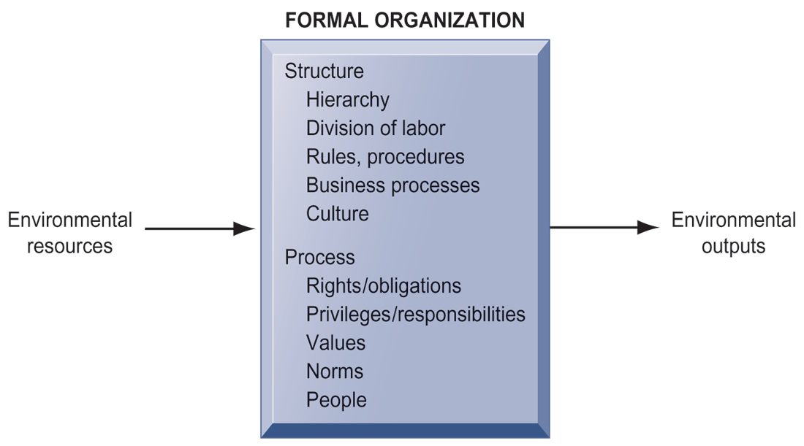
CHAPTER 3: INFORMATION SYSTEMS, ORGANIZATIONS,
AND STRATEGY
Organizations and Information Systems
THE BEHAVIORAL VIEW OF ORGANIZATIONS
FIGURE 3-3
The behavioral view of organizations emphasizes group relationships, values, and structures.
© Pearson Education 2012
Notes:
In this view, the business firm is a little more difficult to change rapidly or on command because it is a very complex machine populated with human beings. Firms operate with an existing hierarchy, job definitions, business rules, legeal contracts, procedures and processes. Efficient organizations become very good at these elements of business. Changing these elements takes more time.

Slide 7
CHAPTER 3: INFORMATION SYSTEMS, ORGANIZATIONS,
AND STRATEGY
Organizations and Information Systems
Features of organizations
    Use of hierarchical structure
    Accountability, authority in system of impartial decision making
    Adherence to principle of efficiency
    Routines and business processes
    Organizational politics, culture, environments and structures
© Pearson Education 2012
Notes:
You could ask students to envision what would happen to an organization that did not use a hierarchical structure (would anything get done?), did not adhere to the principle of efficiency (would they provide any good or service worth using at an affordable price?), etc.

Slide 8
CHAPTER 3: INFORMATION SYSTEMS, ORGANIZATIONS,
AND STRATEGY
Organizations and Information Systems
Routines and business processes
  Routines (standard operating procedures)
    Precise rules, procedures, and practices developed to cope with virtually all expected situations
  Business processes: Collections of routines
  Business firm: Collection of business processes
© Pearson Education 2012
Notes:
You could ask students to describe examples of situations where a business they have interacted with has had a well-understood set of routines. One such example is at the doctor’s office, where the receptionist, nurses, and doctors all have a defined set of routines. Ask students to think about and describe routines they performed on their jobs.

Slide 9
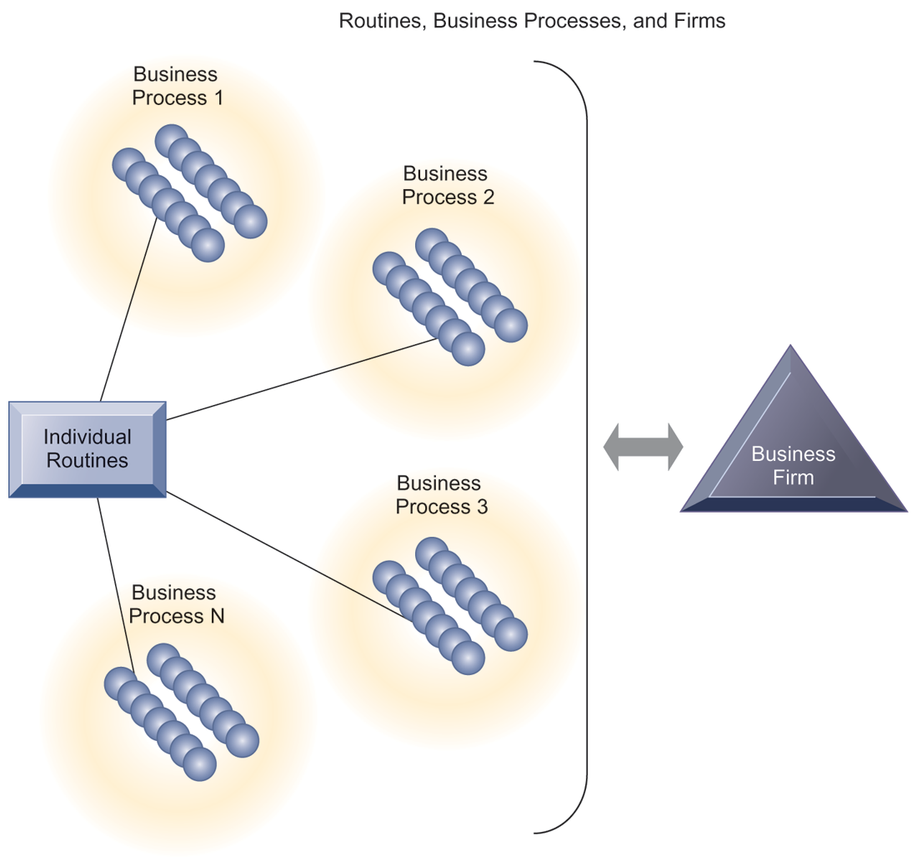
CHAPTER 3: INFORMATION SYSTEMS, ORGANIZATIONS,
AND STRATEGY
Organizations and Information Systems
ROUTINES, BUSINESS PROCESSES, AND FIRMS
All organizations are composed of individual routines and behaviors, a collection of which make up a business process. A collection of business processes make up the business firm. New information system applications require that individual routines and business processes change to achieve high levels of organizational performance.
FIGURE 3-4
© Pearson Education 2012
Notes:
Explain to students that the blue spheres are individual routines, which together constitute a business process. A firm can be seen as a collection of these processes.

Slide 10
CHAPTER 3: INFORMATION SYSTEMS, ORGANIZATIONS,
AND STRATEGY
Organizations and Information Systems
Organizational politics
  Divergent viewpoints lead to political struggle, competition, and conflict
  Political resistance greatly hampers organizational change
© Pearson Education 2012
Notes:
You could ask students to describe examples where organizational politics might hamper a firm’s ability to succeed, or examples where effectively managed organizational politics helps a company to undergo a smoother transition or make more intelligent decisions. Ask students to describe their personal experiences with “organizational politics.”

Slide 11
CHAPTER 3: INFORMATION SYSTEMS, ORGANIZATIONS,
AND STRATEGY
Organizations and Information Systems
Organizational culture:
  Encompasses set of assumptions that define goal and product
    What products the organization should produce
    How and where it should be produced
    For whom the products should be produced
  May be powerful unifying force as well as restraint on change
© Pearson Education 2012
Notes:
Culture may seem like a pretty abstract idea to many students. On the other hand, students with work experiences will easily be able to describe the cultures of firms where they have worked. Ask students to describe organizational cultures they have experienced while on the job, or other areas of their lives. What kind of organizational culture do students prefer and why? Ask students to describe different kinds of cultures and what types of firms are more likely to have them.

Slide 12
CHAPTER 3: INFORMATION SYSTEMS, ORGANIZATIONS,
AND STRATEGY
Organizations and Information Systems
Organizational environments:
  Organizations and environments have a reciprocal relationship
  Organizations are open to, and dependent on, the social and physical environment
  Organizations can influence their environments
  Environments generally change faster than organizations
  Information systems can be an instrument of environmental scanning, act as a lens
© Pearson Education 2012
Notes:
Explain that environmental scanning involves searching for and determining external changes that may require an organizational response. The current economic climate represents an example of external change that requires sweeping organizational responses to ensure survival.

Slide 13
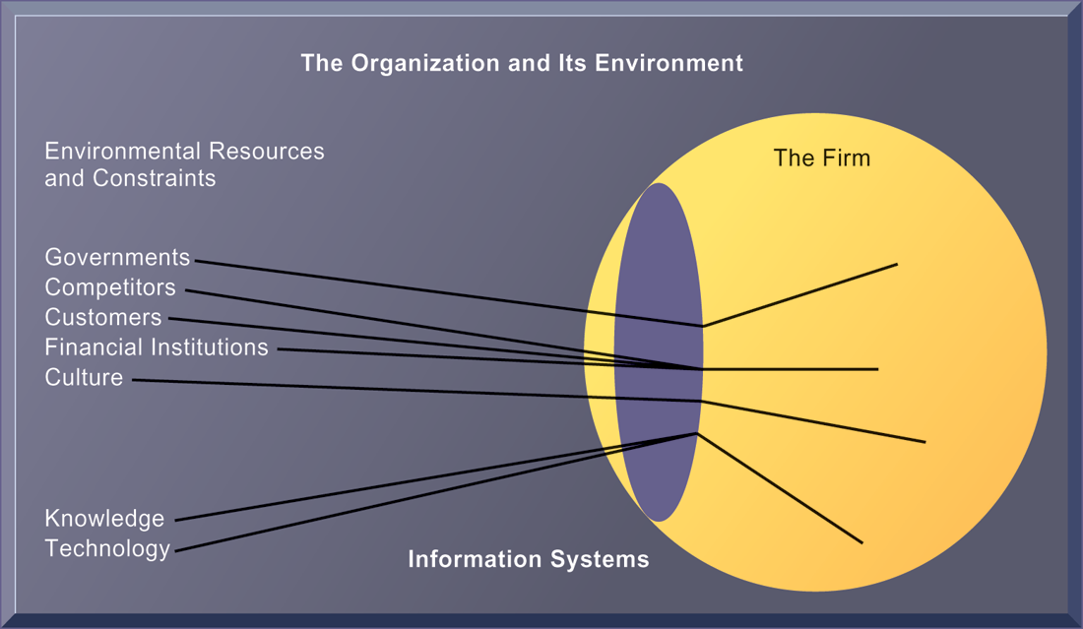
CHAPTER 3: INFORMATION SYSTEMS, ORGANIZATIONS,
AND STRATEGY
Organizations and Information Systems
ENVIRONMENTS AND ORGANIZATIONS HAVE A RECIPROCAL RELATIONSHIP
FIGURE 3-5
Environments shape what organizations can do, but organizations can influence their environments and decide to change environments altogether. Information technology plays a critical role in helping organizations perceive environmental change and in helping organizations act on their environment.
© Pearson Education 2012
Notes:
This graphic further establishes information systems as the ‘lens’ of the firm, observing external factors and filtering information back in to the firm. To some extent, organizations only “see” what their systems will let them see. If systems are poorly built, they may blind managers to difficulties and problems.

Slide 14
CHAPTER 3: INFORMATION SYSTEMS, ORGANIZATIONS,
AND STRATEGY
Organizations and Information Systems
Disruptive technologies
  Technology that brings about sweeping change to businesses, industries, markets
  First movers and fast followers
    First movers – inventors of disruptive technologies
    Fast followers – firms with the size and resources to capitalize on that technology
© Pearson Education 2012
Notes:
Ensure that students understand that the PageRank algorithm is the underlying technology behind Google search. Ask students if they can give examples of any first movers that invented a disruptive technology, yet failed to last (examples might include the Altair personal computer, the Netscape Navigator Internet browser, etc.).

Slide 15
CHAPTER 3: INFORMATION SYSTEMS, ORGANIZATIONS,
AND STRATEGY
How Information Systems Impact Organizations and Business Firms
Economic impacts
  IT changes relative costs of capital and the costs of information
  Information systems technology is a factor of production, like capital and labor
  IT affects the cost and quality of information and changes economics of information
    Information technology helps firms contract in size because it can reduce transaction costs (the cost of participating in markets)
      Outsourcing
© Pearson Education 2012
Notes:
IT figures to replace the function of more middle managers as time passes, as well as reduce the need for other forms of capital (buildings, machinery). Ensure that students understand what is meant by ‘economics of information’ and why outsourcing is a possibility due to IT.

Slide 16
CHAPTER 3: INFORMATION SYSTEMS, ORGANIZATIONS,
AND STRATEGY
How Information Systems Impact Organizations and Business Firms
Transaction cost theory
  Firms seek to economize on transaction costs (the costs of participating in markets)
  IT lowers market transaction costs for a firm, making it worthwhile for firms to transact with other firms rather than grow the number of employees
© Pearson Education 2012
Notes:
Explain that using the market can be expensive. If you depend on the market, rather than hiring employees, you will need to search for talent, research the quality of providers and workers, write contracts for work to be performed, monitor the work, and so forth. When participation in markets is expensive, firms would rather hire employees to accomplish their work. But the Internet makes it less expensive to use the marketplace. With the Internet, firms find it more cost effective to use the marketplace and contract for work in a market, rather than hire employees. Ask your students why the Internet can make participating in markets less expensive than before.

Slide 17
CHAPTER 3: INFORMATION SYSTEMS, ORGANIZATIONS,
AND STRATEGY
How Information Systems Impact Organizations and Business Firms
Organizational and behavioral impacts
  IT flattens organizations
    Decision making pushed to lower levels
    Fewer managers needed (IT enables faster decision making and increases span of control)
  Postindustrial organizations
    Organizations flatten because in postindustrial societies, authority increasingly relies on knowledge and competence rather than formal positions
© Pearson Education 2012
Notes:
Ask students to explain what is meant by authority relying on knowledge and competence rather than formal positions. Why might this ‘flatten’ the organization? The idea here is that with sufficient IT, competent workers will be able to accomplish more on their own than they would under a more hierarchical arrangement.

Slide 18
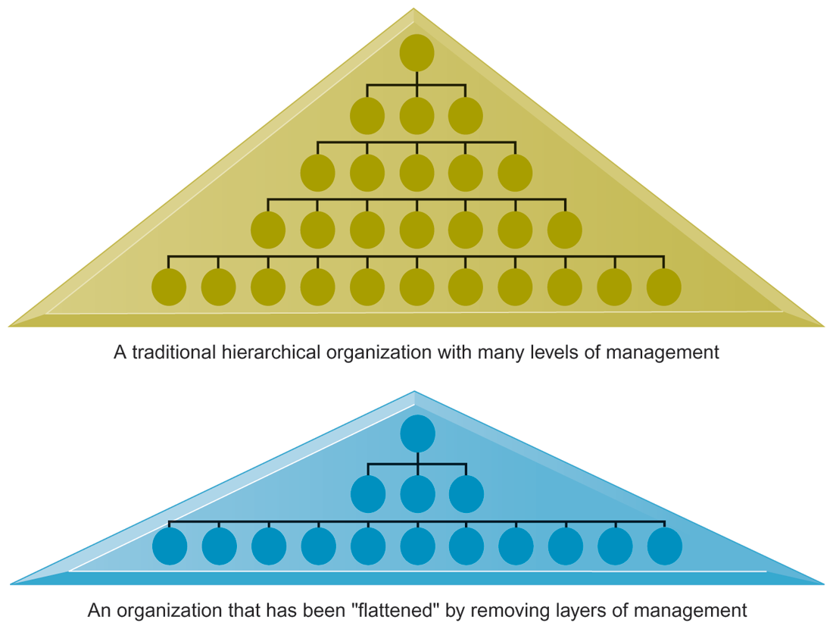
CHAPTER 3: INFORMATION SYSTEMS, ORGANIZATIONS,
AND STRATEGY
How Information Systems Impact Organizations and Business Firms
FLATTENING ORGANIZATIONS
Information systems can reduce the number of levels in an organization by providing managers with information to supervise larger numbers of workers and by giving lower-level employees more decision-making authority.
FIGURE 3-8
© Pearson Education 2012
Notes:
Ask students to explain some of the benefits of the flattened organization as opposed to the more complicated hierarchy in the top of the diagram. Information travels through fewer levels to its intended recipients; there are fewer managers, so agency costs are smaller, and firms can act faster (less decision delay).

Slide 19
CHAPTER 3: INFORMATION SYSTEMS, ORGANIZATIONS,
AND STRATEGY
How Information Systems Impact Organizations and Business Firms
Organizational resistance to change
  Information systems become bound up in organizational politics because they influence access to a key resource – information
  Information systems potentially change an organization’s structure, culture, politics, and work
  Most common reason for failure of large projects is due to organizational and political resistance to change
© Pearson Education 2012
Notes:
Explain what is meant by changes in culture and politics of the firm. For example, workers may resist changes that disrupt their routines. Also explain to students that as important as technical understanding of information systems may be for potential managers, it is equally important to understand the people and organizational structures and customs affected by information systems.

Slide 20
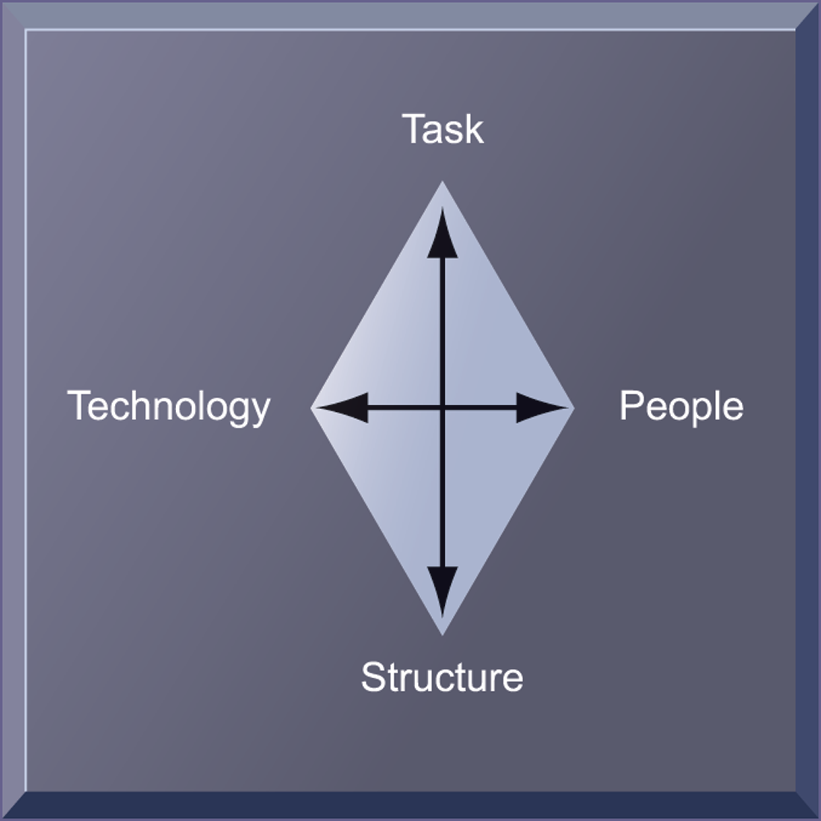
CHAPTER 3: INFORMATION SYSTEMS, ORGANIZATIONS,
AND STRATEGY
How Information Systems Impact Organizations and Business Firms
ORGANIZATIONAL RESISTANCE AND THE MUTUALLY ADJUSTING RELATIONSHIP BETWEEN TECHNOLOGY AND THE ORGANIZATION
Implementing information systems has consequences for task arrangements, structures, and people. According to this model, to implement change, all four components must be changed simultaneously.
FIGURE 3-9
© Pearson Education 2012
Notes:
The diamond shape in the figure represents the mutual relationship between the concepts shown. You could emphasize that implementing a new system might be like changing the diamond into a square, thus requiring some degree of change on the part of all four participants in the relationship.

Slide 21
CHAPTER 3: INFORMATION SYSTEMS, ORGANIZATIONS,
AND STRATEGY
How Information Systems Impact Organizations and Business Firms
The Internet and organizations
  The Internet increases the accessibility, storage, and distribution of information and knowledge for organizations
  The Internet can greatly lower transaction and agency costs
© Pearson Education 2012
Notes:
The Internet should also have a flattening effect on many organizations. Can students describe any businesses that have become more efficient and flat thanks to successful incorporation of the Internet in their operations? Some older students may remember the “bad old days” when seven or more levels of management needed to decide even simple issues in a typical firm.

Slide 22
CHAPTER 3: INFORMATION SYSTEMS, ORGANIZATIONS,
AND STRATEGY
How Information Systems Impact Organizations and Business Firms
Central organizational factors to consider when planning a new system:
  Environment
  Structure
    Hierarchy, specialization, routines, business processes
  Culture and politics
  Type of organization and style of leadership
  Main interest groups affected by system; attitudes of end users
  Tasks, decisions, and business processes the system will assist
© Pearson Education 2012
Notes:
Ask students to consider the results of an information system implemented without properly considering each of the above factors. For example, an information system designed without an understanding of the company’s culture and politics is likely to be unpopular, perhaps forcing employees to drastically deviate from their previous routines.

Slide 23
CHAPTER 3: INFORMATION SYSTEMS, ORGANIZATIONS,
AND STRATEGY
Using Information Systems to Achieve Competitive Advantage
Why do some firms become leaders in their industry?
Michael Porter’s competitive forces model
  Provides general view of firm, its competitors, and environment
  Five competitive forces shape fate of firm
    Traditional competitors
    New market entrants
    Substitute products and services
    Customers
    Suppliers
© Pearson Education 2012
Notes:
Porter’s competitive forces model is intended to explain why some firms do better than others. Do students believe that this model captures this idea effectively? Which factor is most important to a firm’s success? You can make a list of five well-known firms on the blackboard or screen and ask students for each firm which do they think are the most important competitive forces.

Slide 24
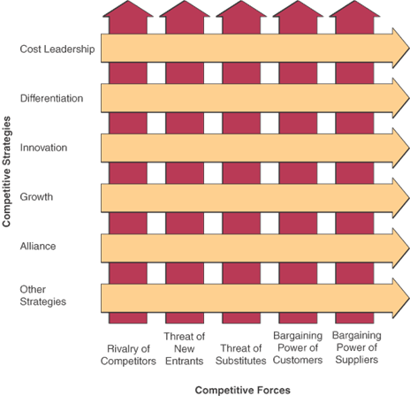
Competitive Forces and Strategies
2-<number>

Slide 25
CHAPTER 3: INFORMATION SYSTEMS, ORGANIZATIONS,
AND STRATEGY
Using Information Systems to Achieve Competitive Advantage
Rivalry competitors
  All firms share market space with competitors who are continuously devising new products, services, efficiencies, switching costs
Threat of New market entrants
  Some industries have high barriers to entry, e.g. computer chip business
  New companies have new equipment, younger workers, but little brand recognition
© Pearson Education 2012
Notes:
Ask students to name different industries and describe the benefits and drawbacks of being a new market entrant in each industry.

Slide 26
CHAPTER 3: INFORMATION SYSTEMS, ORGANIZATIONS,
AND STRATEGY
Using Information Systems to Achieve Competitive Advantage
Threat of Substitute products and services
  Substitutes customers might use if your prices become too high, e.g. iTunes substitutes for CDs
Bargaining Power of Customers
  Can customers easily switch to competitor’s products? Can they force businesses to compete on price alone in transparent marketplace?
Bargaining Power of Suppliers
  Market power of suppliers when firm cannot raise prices as fast as suppliers
© Pearson Education 2012
Notes:
Ask students to name different businesses and describe whether or not customers have great control over the business or vice versa, or whether substitute products are a large or insignificant threat to the success of the business.

Slide 27
Five Competitive Strategies
Cost Leadership
  Become low-cost producers
  Help suppliers or customers reduce costs
  Increase cost to competitors
    Example: Priceline uses online seller bidding so the buyer sets the price
Differentiation Strategy
  Differentiate a firm’s products from its competitors’
  Focus on a particular segment or niche of market
2-<number>

Slide 28
Competitive Strategies (continued)
Innovation Strategy
  Unique products, services, or markets
  Radical changes to business processes
    Example: Amazon’s online, full-service customer systems
Growth Strategy
  Expand company’s capacity to produce
  Expand into global markets
  Diversify into new products or services
2-<number>

Slide 29
Competitive Strategies (continued)
Alliance Strategy
  Establish linkages and alliances with customers, suppliers, competitors, consultants, and other companies
  Includes mergers, acquisitions, joint ventures, virtual companies
    Example: Wal-Mart uses automatic inventory replenishment by supplier
2-<number>

Slide 30
Using Competitive Strategies
These strategies are not mutually exclusive
  Organizations use one, some, or all
  A given activity could fall into one or more categories of competitive strategy
Not everything innovative serves to differentiate one organization from another
  Likewise, not everything that differentiates organizations is necessarily innovative
2-<number>

Slide 31
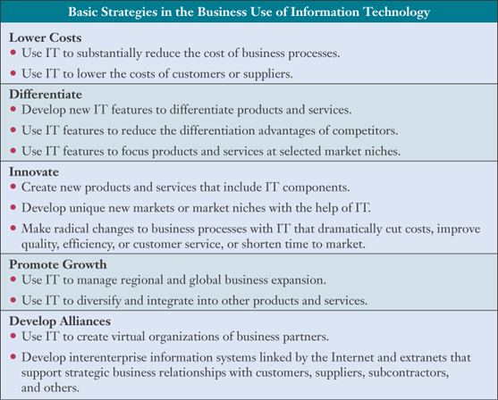
Ways to Implement Basic Strategies
2-<number>

Slide 32
Other Competitive Strategies
Lock in Customers and Suppliers
  Deter them from switching to competitors
Build in Switching Costs
  Make customers and suppliers dependent on the use of innovative IS
Erect Barriers to Entry
  Discourage or delay other companies from entering the market
  Increase the technology or investment needed to enter
2-<number>

Slide 33
Other Competitive Strategies
Build Strategic IT Capabilities
  Take advantage of strategic opportunities when they arise
  Improve efficiency of business practices
Leverage Investment in IT
  Develop products and service that would not be possible without a strong IT capability
2-<number>

Slide 34
CHAPTER 3: INFORMATION SYSTEMS, ORGANIZATIONS,
AND STRATEGY
Using Information Systems to Achieve Competitive Advantage
The Internet’s impact on competitive advantage
  Transformation, destruction, threat to some industries
    E.g. travel agency, printed encyclopedia, newspaper
  Competitive forces still at work, but rivalry more intense
  Universal standards allow new rivals, entrants to market
  New opportunities for building brands and loyal customer bases
© Pearson Education 2012
Notes:
Do students believe it is easier or harder to gain a competitive advantage via the Internet as opposed to more traditional means? Table 3-5 describes the impact of the Internet on various competitive forces.

Slide 35
CHAPTER 3: INFORMATION SYSTEMS, ORGANIZATIONS,
AND STRATEGY
Using Information Systems to Achieve Competitive Advantage
Business value chain model
  Views firm as series of activities that add value to products or services
  Highlights activities where competitive strategies can best be applied
    Primary activities vs. support activities
  At each stage, determine how information systems can improve operational efficiency and improve customer and supplier intimacy
  Utilize benchmarking, industry best practices
© Pearson Education 2012
Notes:
How does the value chain model differ from the Porter model? (It offers more specific detail about what exactly to do to achieve competitive advantages.) How do primary activities differ from support activities?

Slide 36
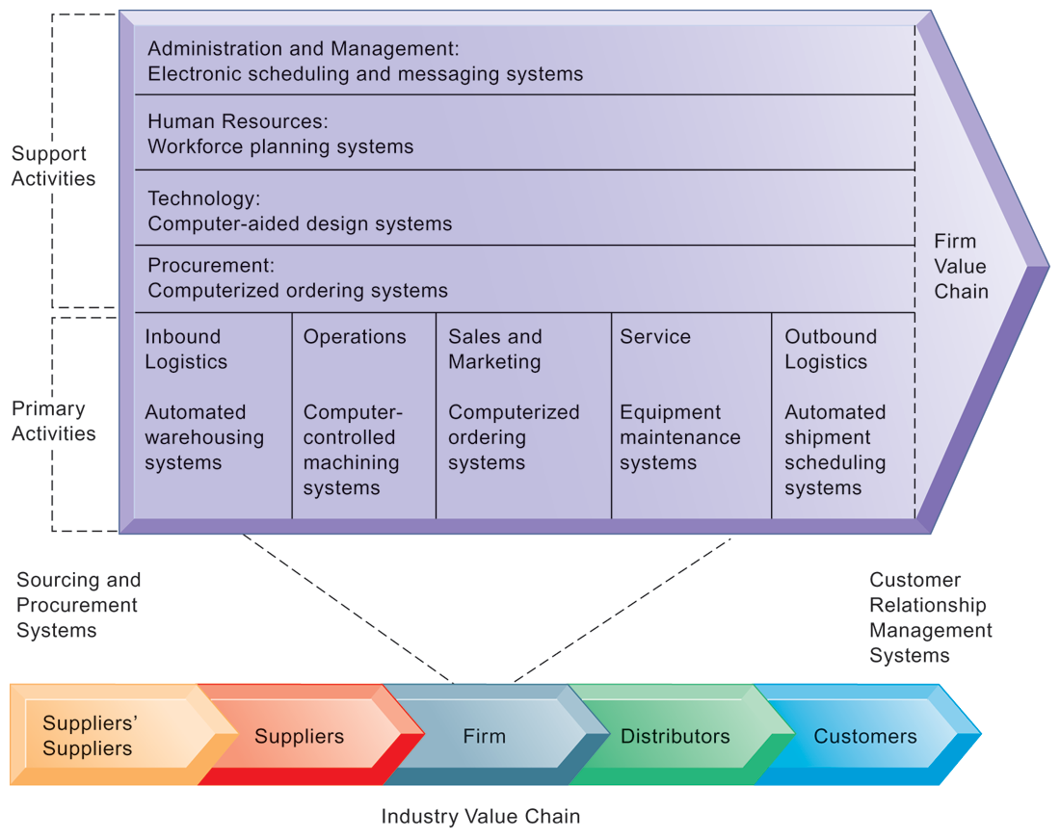
CHAPTER 3: INFORMATION SYSTEMS, ORGANIZATIONS,
AND STRATEGY
Using Information Systems to Achieve Competitive Advantage
THE VALUE CHAIN MODEL
This figure provides examples of systems for both primary and support activities of a firm and of its value partners that can add a margin of value to a firm’s products or services.
FIGURE 3-11
© Pearson Education 2012
Notes:
Emphasize the relationship between the primary and support activities of this firm and explain how information systems are critical to the success of each activity.

Slide 37
CHAPTER 3: INFORMATION SYSTEMS, ORGANIZATIONS,
AND STRATEGY
Using Information Systems to Achieve Competitive Advantage
Network-based strategies
  Take advantage of firm’s abilities to network with each other
  Include use of:
    Network economics
    Virtual company model
    Business ecosystems
© Pearson Education 2012
Notes:
Examples of firms that use this type of strategy to achieve an advantage are eBay and iVillage. Many other companies are following suit in using a network-based strategy – can students name any? eBay, iVillage, and social networking firms like Facebook, are based on networks of millions of users. These companies have used the Web and Internet communication tools to build communities. The more people who join these communities, the more benefit members receive.

Slide 38
CHAPTER 3: INFORMATION SYSTEMS, ORGANIZATIONS,
AND STRATEGY
Using Information Systems to Achieve Competitive Advantage
Virtual company strategy
  Virtual company uses networks to ally with other companies to create and distribute products without being limited by traditional organizational boundaries or physical locations
© Pearson Education 2012
Notes:
Explain to students that companies like this are ‘virtual’ because they do not actually own any factories, machines, or other similar infrastructure. Instead, they offer a series of services, aided by information systems and uninhibited by geographical boundaries.

